Slide 1

Severity Prediction of Car Accidents in US
Team Members: 1)Aditya Bandaru 2)Anusha Balumuri 3)Ranga Sai Pavan Kiran Vipparla 4)Sandeep Bellary 5)Siri Chandana Sureddi

Slide 2
Problem Domain :
Road accidents are a common cause of death, injury, collateral damage and a significant public health and road safety problem.
Accidents are also a significant cause of congestion and delays in traffic.
On average, almost 5,000 people are killed, and more than 418,000 people are injured in weather-related incidents every year.
As one of the main steps in preventing incidents, forecasting the extent of incidents will provide valuable information for emergency responders to determine the extent of injuries, evaluate possible effects, and execute effective accident response procedures.

Slide 3
Dataset
This is a countrywide dataset for traffic accidents, representing 49 States of the United States.
The accident data was collected from February 2016 to December 2019 using a variety of data providers, including two APIs that provide streaming traffic incident data.
Such APIs transmit traffic data obtained by a number of organisations, such as the U.S. and State Departments of Transport, law enforcement agencies, traffic cameras, and road-network traffic sensors.
There are currently around 3.0 million incident reports in this dataset.

Slide 4


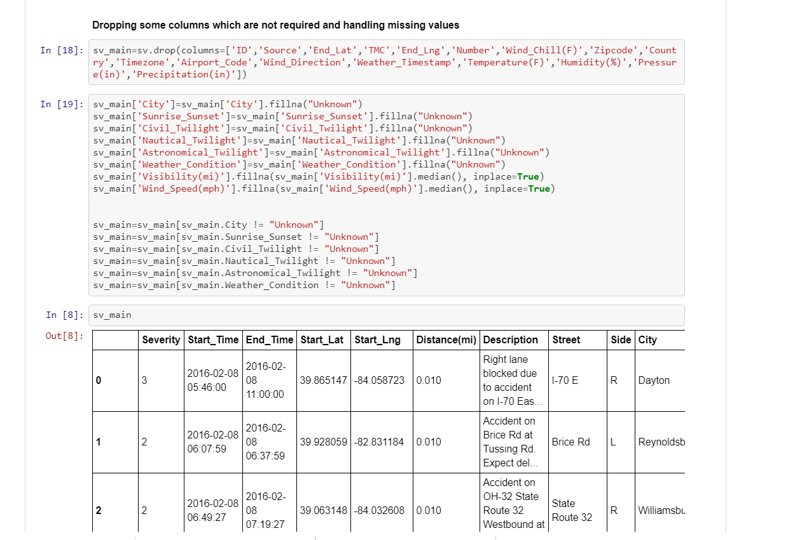
Data Pre-Processing
We have preprocessed the data by removing unnecessary columns as show in the image.
The missing data is handled by assigning the value “Unknown” and dropping the rows which has that value.

Slide 5
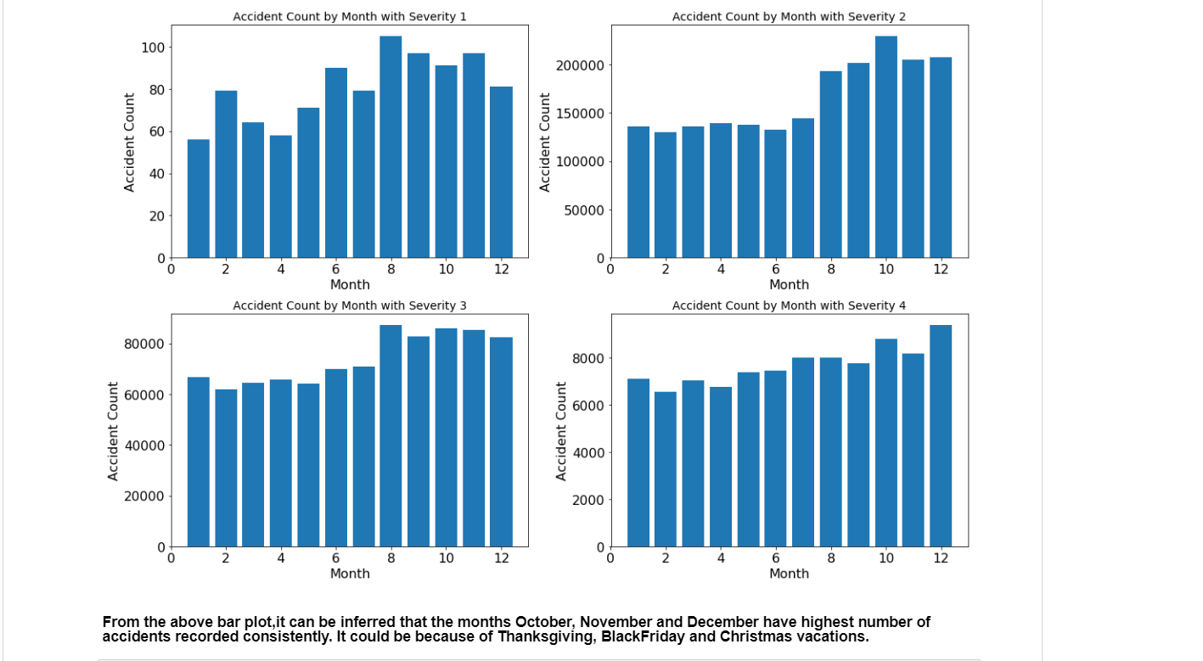

Slide 6
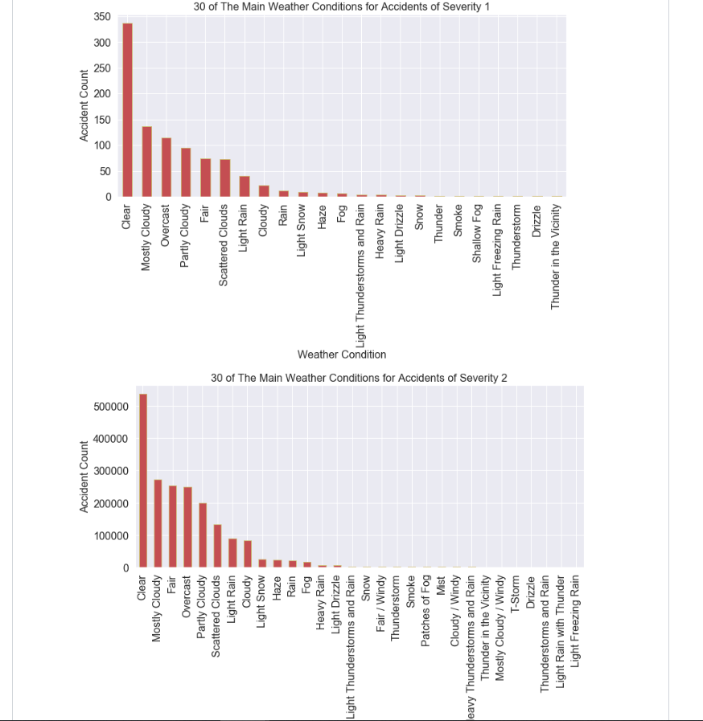

Slide 7
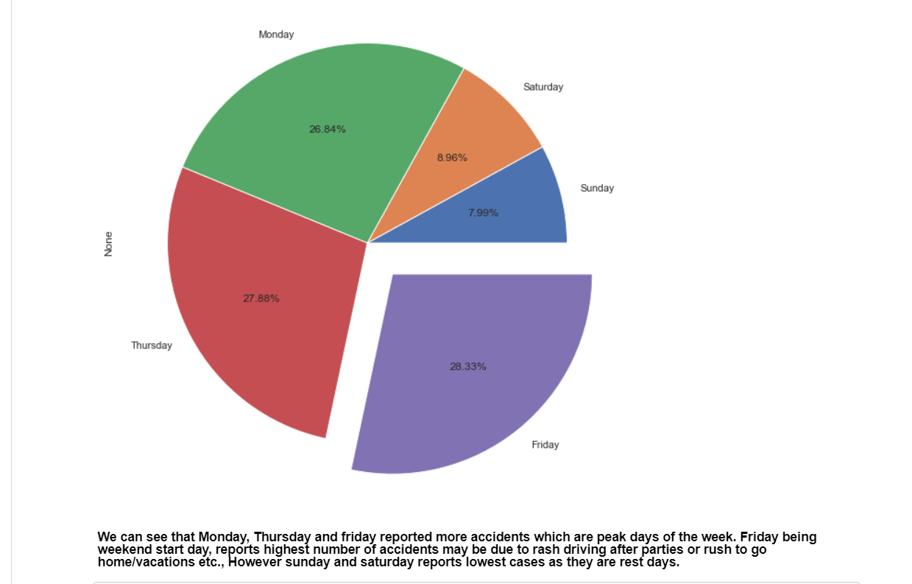

Slide 8
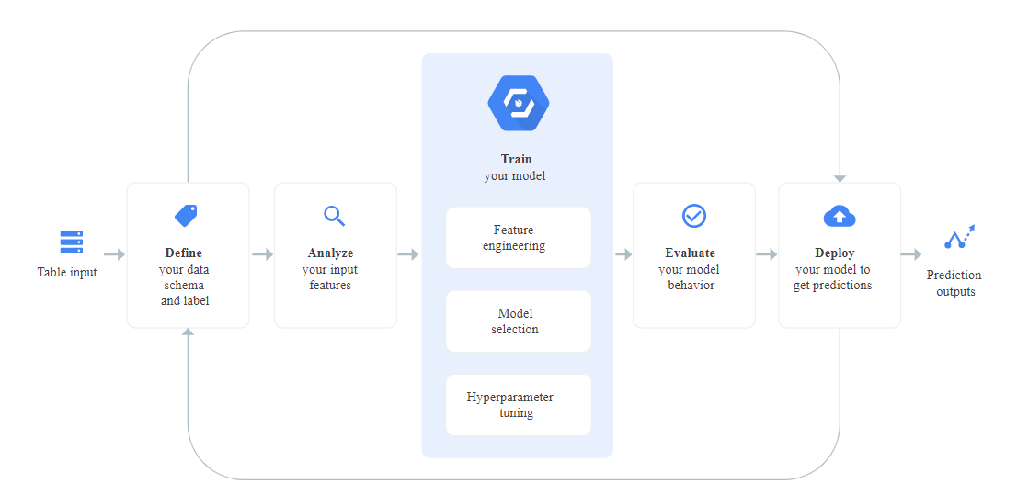
Modelling Techniques: Auto ML

Slide 9
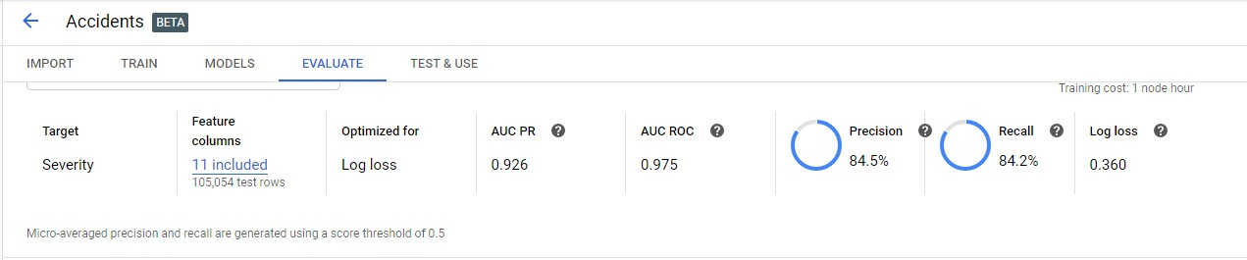
Modelling results

Slide 10
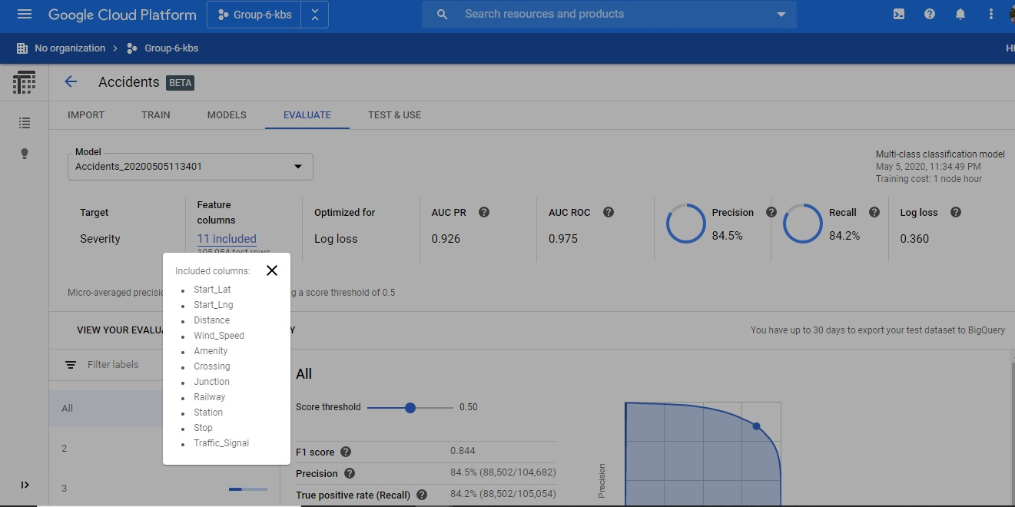

Slide 11
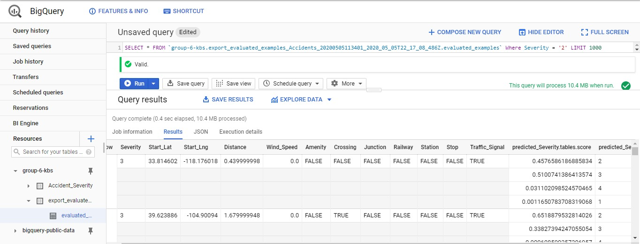

Slide 12
Few More Modelling techniques
We have used various models like Linear Regression, Logistic Regression and Light GBM.
By using Linear Regression model we obtained a accuracy of around 67% and with Logistic Regression we got around 66%.
So, we have used the Light GBM model which resulted in the accuracy of 88%.

Slide 13
Light GBM
Light GBM is a high-performance and distributed decision tree-based system used for classification, ranking and many other forms of machine learning tasks.
The primary benefit of the Light GBM is the algorithm improvements that significantly speed up the process and contribute to the creation of an efficient model.

Slide 14
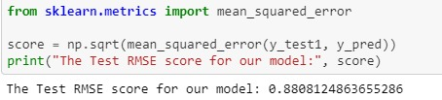
Light GBM Results

Slide 15
Thank you ☺

